Slide 1
Project
1) Find a dataset (assuming you don’t have one already)
Route 1: Look for papers (Google scholar)
Route 2: Look for datasets (Dryad)
2) Do some reading of the paper to see what is currently known in that field
This is your Background
3) Come up with a research question
Use the variables in the dataset; ask a different question from the paper
Ask yourself: what type of variables do you have? Therefore what type of analysis would I have to use? (You will have a better idea of what I mean after today’s lecture)
4) Write the Abstract (for the proposal based on the above). See the sample provided in Canvas.
Proposal is due in 2 weeks: 12 Feb 2359h

Slide 2

Basic Statistical Concepts and Tests
Lecture 3
LSM3257
AY22/23; Sem 2 | Ian Z.W. Chan

Slide 3
Summary (Learning Objectives)
Basic statistical concepts
- Variable types:
Properties: Continuous vs. Categorical vs. Discrete
Function: Explanatory vs. Response
- Describing data: Mean, Variance, df, SD, SE, Confidence Intervals
- Modelling data with Distributions: continuous and discrete
Basic statistical tests
- Experimental design
- Test assumptions: Independent and Identically Distributed, normality, equal variances; testing for normality and equal variances
- Tests: based on number and type of explanatory and response variables
- Other considerations: Corrections for multiple comparisons, Power analysis
Notes:
Pearson’s Chi-squared test, one-sample t-test, Wilcoxon one-sample test, point biserial correlation, Pearson/Spearman correlation, Pearson’s Chi-squared/Fisher’s Exact test, Two proportions test, t-test, Welch’s t-test, Mann Whitney U test, Paired t-test, Paired Wilcoxon signed rank test

Slide 4
Part 1: Basic Concepts Variable types
Categorical vs. Continuous vs. Discrete
X vs. Y: Explanatory vs. Response

Slide 5
Types of variables (properties): categorical vs. continuous vs. discrete
Categorical: Variables with a finite number of groups
- Ordinal: categories with a logical order, e.g. Clothing size
- Nominal: categories without a logical order, e.g. Ethnic group
Continuous: Variables with infinite number of values between any two values
- E.g. Length, Height, Weight, Area
Discrete: Numeric variables that have a countable number of values between any two values
- Can be treated as categorical or continuous based on the number of different values
- Size of the values also affects the type of tests you should use (more on this later)
- E.g. Number of students

Slide 6
Types of variables (function): explanatory vs. response
X-axis
Predict or explain differences in another variable
Example: pollution levels in a land plot
Many names:
Explanatory variable
Predictor variable
Independent variable
Control variable
Regressor
Y-axis
The variable to be predicted or explained
Example: biodiversity in that plot
Response variable
Predicted variable
Dependent variable
Outcome variable
Regressand

Slide 7
Types of variables: explanatory vs. response
Response variable
Predicted variable
Outcome variable
Dependent variable
Y-axis
Example: Biodiversity
X-axis
Explanatory variable
Predictor variable
Control variable
Independent variable
Example: Pollution level

Slide 8
Describing data

Slide 9
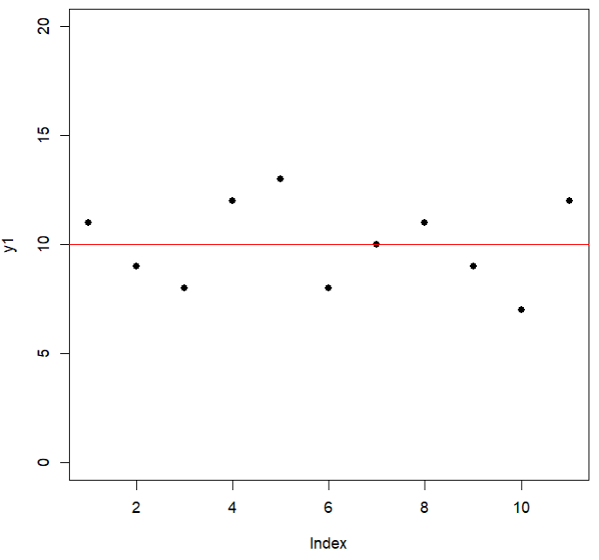

Mean
#Imagine these data:
y1=c(11,9,8,12,13,8,10,11,9,7,12)
plot(y1,ylim=c(0,20),pch=16)
How do we describe the data?:
1) The central (Mean) value
#Plot mean line
abline(h=mean(y1),col="red")
This is great! It gives us an idea of what the values are like.
But that doesn’t tell us about how spread out the datapoints are, so…
$$\overline{y}$$

Slide 10
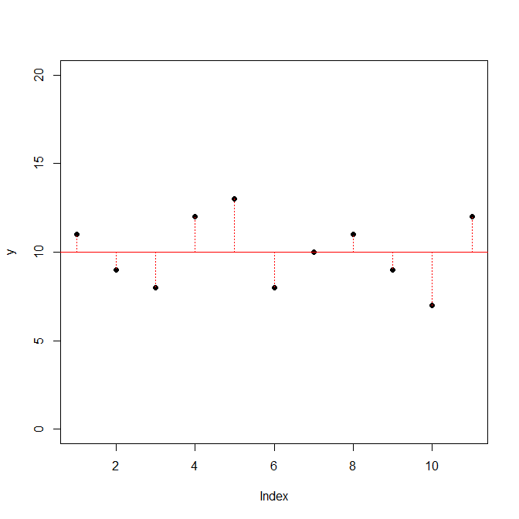



Variance
2) The Variance
Variability is probably the most important measure of data in statistical analyses.
- More variability in the data = more uncertainty with our results (the values of the parameters estimated) = less ability to distinguish between competing hypothesis (e.g. null vs. alternative).
Conclusion: high variability is bad.
$$y$$
$$d$$
$$\overline{y}$$
One way to measure variability is to calculate the distance between each point and the mean.
#Plot distances to the mean
segments(x0=seq(1,11),x1=seq(1,11),y0=mean(y1),y1=y1,col="red",lty=3)

Slide 11




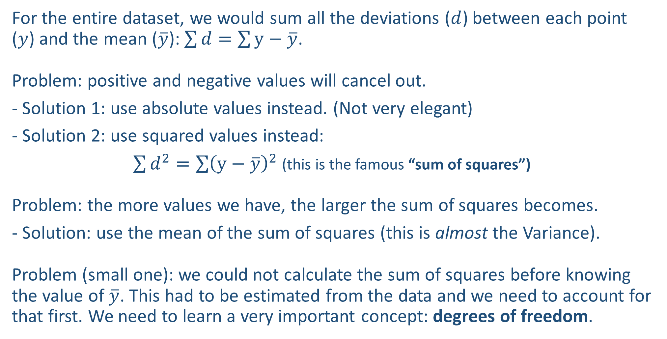







Variance—how to calculate?
For the entire dataset, we would sum all the deviations ($d$) between each point ($y$) and the mean ($\overline{y}$): $\sum{d}=\sum{y−\overline{y}}$.
Problem: positive and negative values will cancel out.
- Solution 1: use absolute values instead. (Not very elegant)
- Solution 2: use squared values instead:
$\sum{d^{2}}=\sum{{\left(y−\overline{y}\right)}^{2}}$ (this is the famous “sum of squares”)
Problem: the more values we have, the larger the sum of squares becomes.
- Solution: use the mean of the sum of squares (this is almost the Variance).
Problem (small one): we could not calculate the sum of squares before knowing the value of $\overline{y}$. This had to be estimated from the data and we need to account for that first. We need to learn a very important concept: degrees of freedom.
$$d_{4}^{2}$$
$$d_{5}^{2}$$
$$d_{11}^{2}$$
$$d_{1}^{2}$$
$$d_{7}^{2}$$
$$d_{8}^{2}$$
$$d_{2}^{2}$$
$$d_{3}^{2}$$
$$d_{6}^{2}$$
$$d_{9}^{2}$$
$$d_{10}^{2}$$

Slide 12
Variance—degrees of freedom
Why do we use df instead of n?
To get a truer estimate of our uncertainty, we need to account for the fact that we actually only had n-1 “free” datapoints: dividing by a smaller number gives you larger uncertainty.
Read here:
https://medium.com/@dlectus/degrees-of-freedom-simply-explained-a96cafa3b39f
Degrees of freedom (df): the number of values in a dataset with the “freedom to vary”.
Example
n = 3
The first number has the freedom to be anything:
The second number still has the freedom to be anything:
The third number has no freedom, it MUST be 6!
This dataset of n = 3 had df = 2 (two numbers can vary freely).
In general: we will have n-1 degrees of freedom if we estimate one parameter (in this case, the mean) from the sample.
 |  |  | mean = 5
4 |  |  | mean = 5
4 | 5 |  | mean = 5

Slide 13
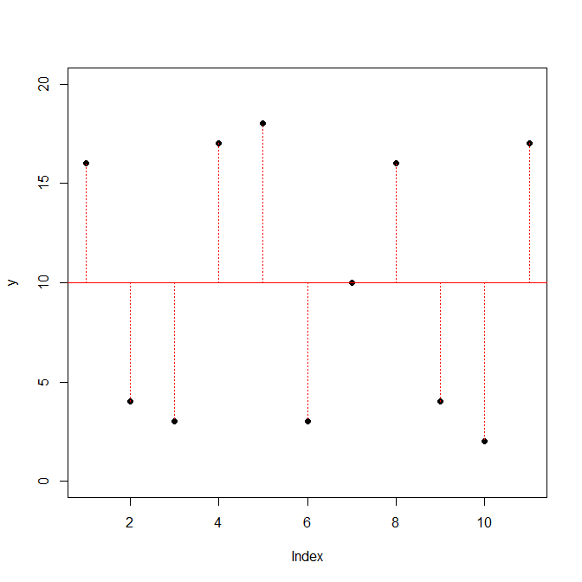

Variance & Standard Deviation
We can now calculate the variance:
$$\text{V}\text{ariance} \text{=}\frac{\text{sum} \text{of} \text{squares}}{\text{degrees} \text{of} \text{freedom}}=\frac{{\sum{\left(y−\overline{y}\right)}}^{2}}{n−1}$$
Last step: we take the square root of the Variance to convert Variance back to the original units – this is known as the Standard Deviation (SD): Variance = SD²
Understanding Variance will be important later on when choosing statistical tests
SD = 1.95
SD = 6.84
2 datasets
Same Mean
Different Variance
Which mean looks more reliable?

Slide 14
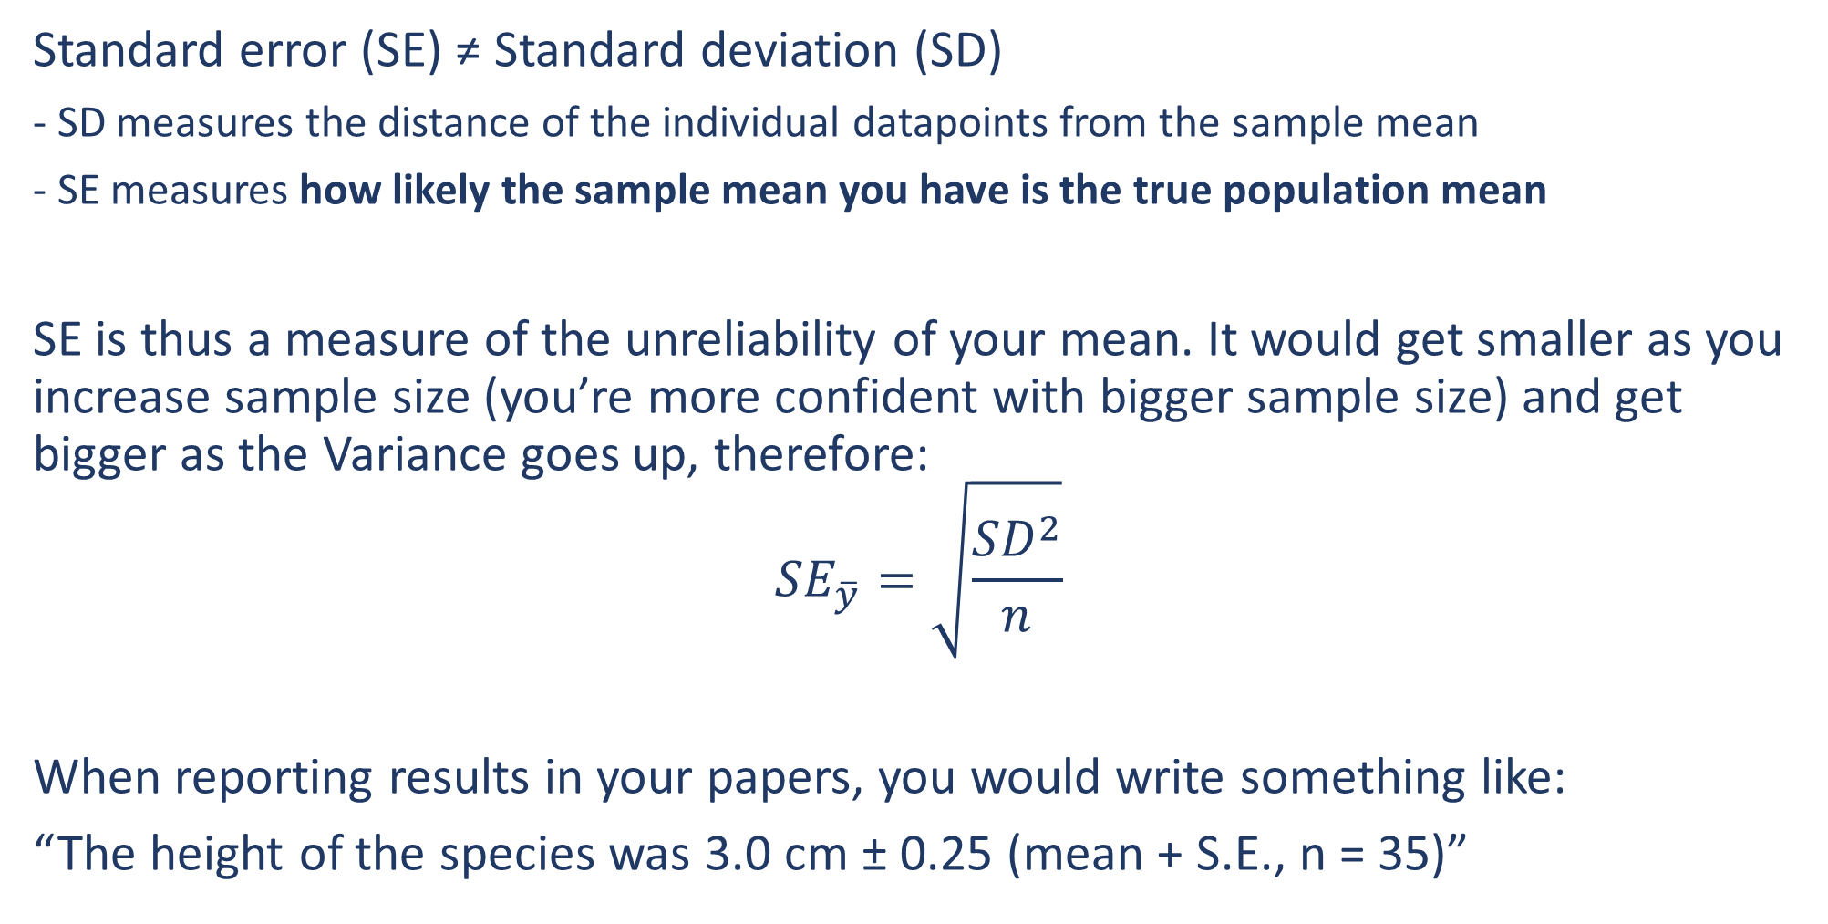
Standard Error
Standard error (SE) ≠ Standard deviation (SD)
- SD measures the distance of the individual datapoints from the sample mean
- SE measures how likely the sample mean you have is the true population mean
SE is thus a measure of the unreliability of your mean. It would get smaller as you increase sample size (you’re more confident with bigger sample size) and get bigger as the Variance goes up, therefore:
$${SE}_{\overline{y}}=\sqrt{\frac{{SD}^{2}}{n}}$$
When reporting results in your papers, you would write something like:
“The height of the species was 3.0 cm ± 0.25 (mean + S.E., n = 35)”

Slide 15
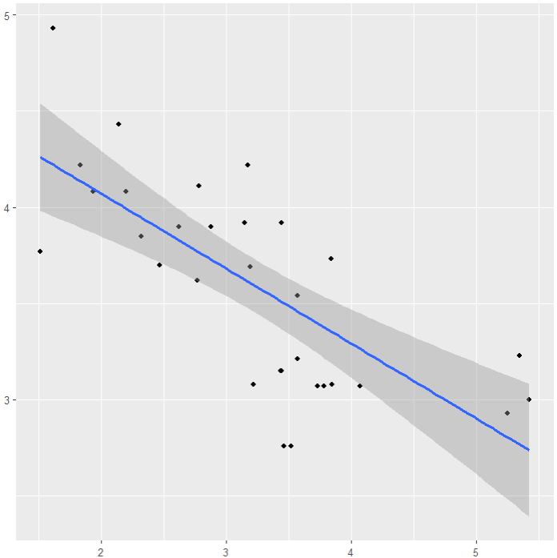
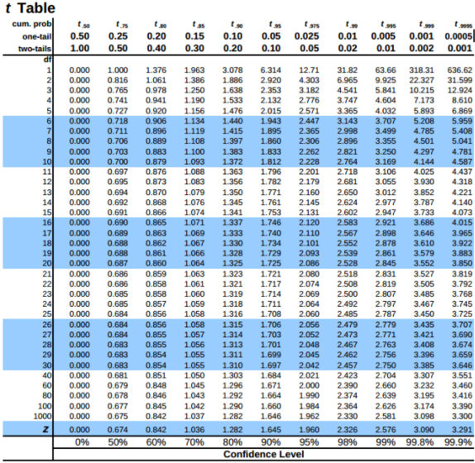
Confidence Intervals
Confidence intervals show the likely range in which the sample mean would fall if you repeated your sampling multiple times.
It is a measure of the (un)reliability of your model and would:
- Increase with SD
- Decrease with n
- Increase with confidence level
How to calculate?:
- Old school, checked in tables like this…
The shaded area is the confidence interval of the blue line
Question: why does it get bigger towards the ends?
Source: https://www.sjsu.edu/faculty/Gerstman/StatPrimer/t-table.pdf

Slide 16
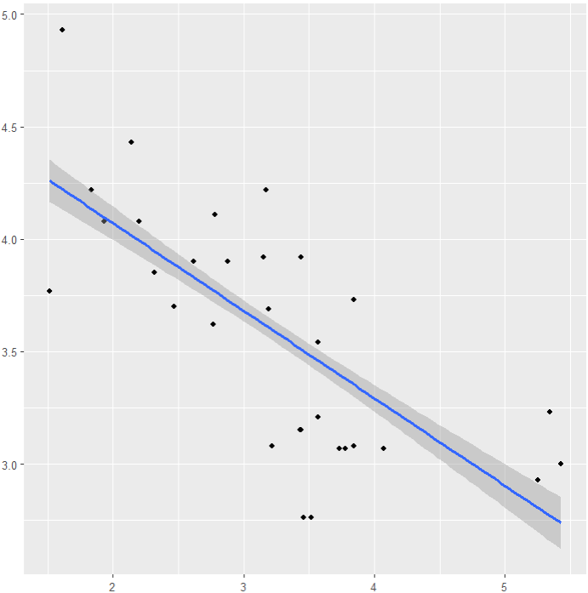
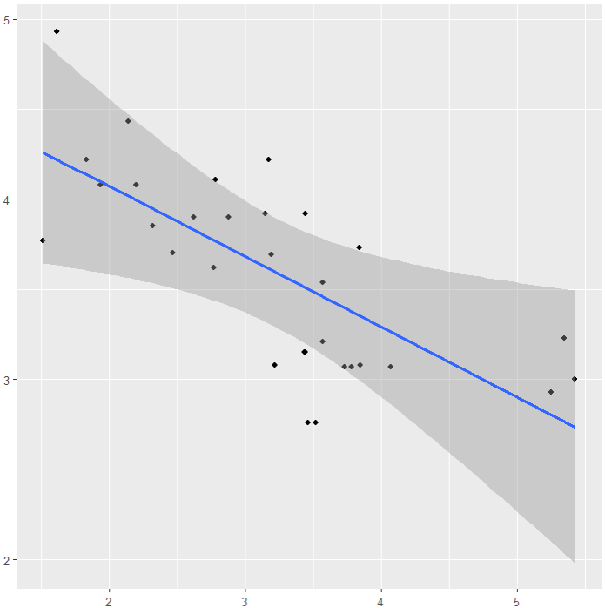
Confidence Intervals
95%
Debugging Time!
Can you spot the error in this slide?
How to calculate?:
- Now we can easily calculate and plot them…
library(ggplot2)
f=ggplot(mtcars,aes(x=wt,col=drat))
f+geom_point()+geom_smooth(method=lm,level=0.95) #default 95%
f+geom_point()+geom_smooth(method=lm,level=0.5) #50% confidence level, smaller interval!
f+geom_point()+geom_smooth(method=lm,level=0.9999) #99.99% confidence level, larger interval!
50%
99.99%

Slide 17
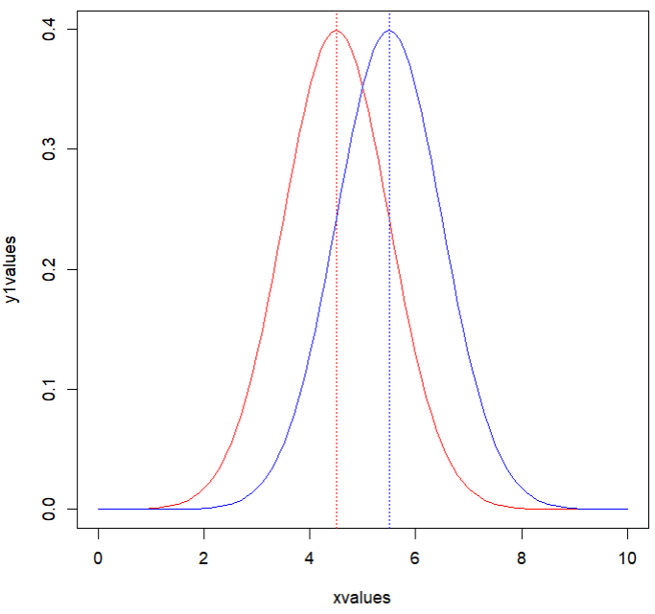
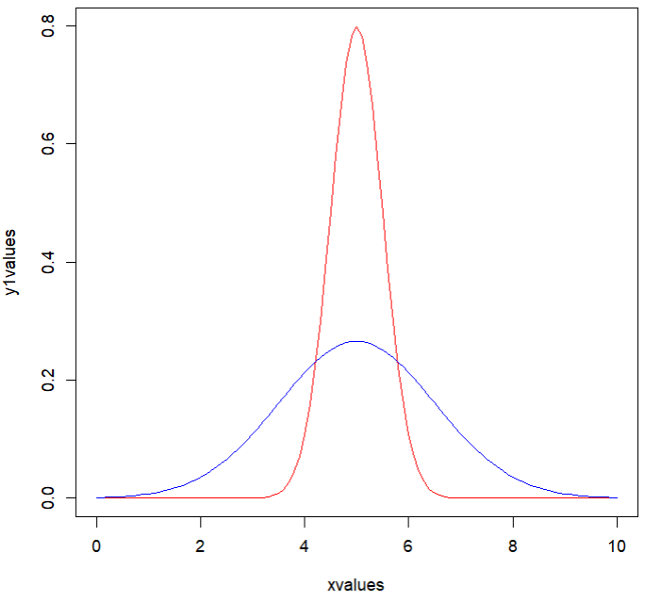
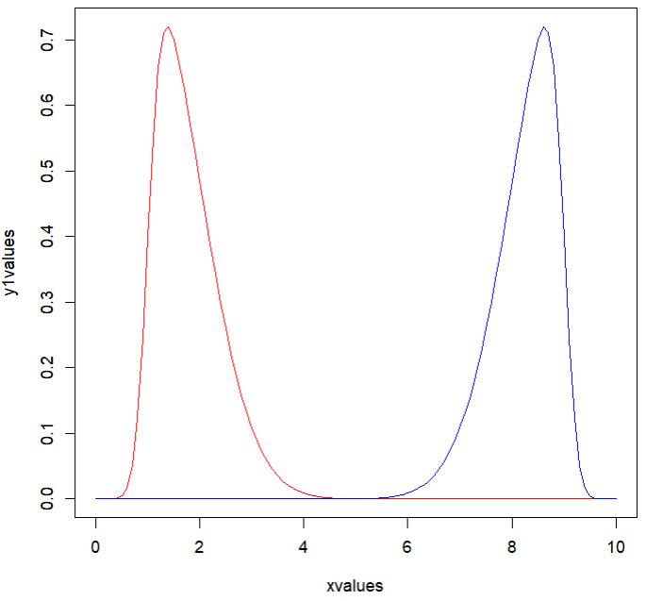
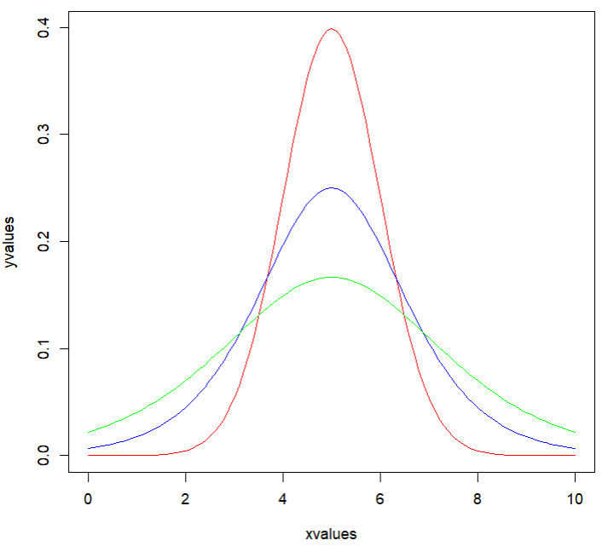
4 moments of distributions
Moment 1: Mean Moment 2: Variance
Moment 3: Skew Moment 4: Kurtosis
SD=0.5
SD=1.5
Positive (right) skew
Leptokurtic (thin)
Negative (left) skew
Mesokurtic
Platykurtic (flat)

Slide 18
Modelling data
Distributions

Slide 19
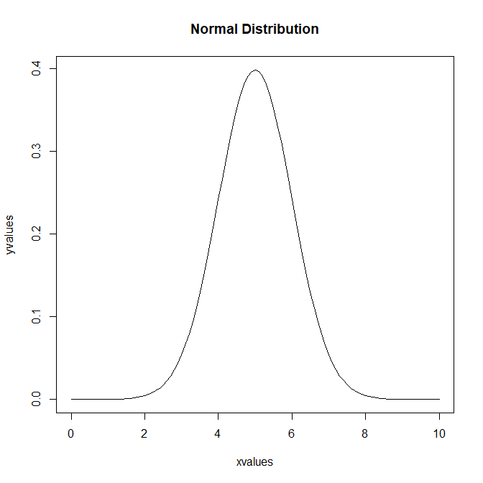
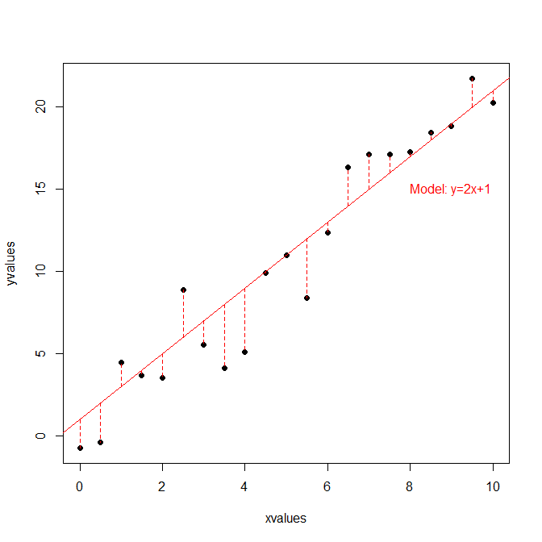
Distributions
Mathematical functions that are used to model the values of your variables: different functions have different parameters and can take different shapes
- 2 types: Continuous distributions (for continuous data) and Discrete distributions (for categorical data)
- No distribution will fit your data perfectly; we always choose the best
Some analyses assume that your data follow certain distributions
- If this is not true, then you cannot use the analysis
Example: Normal distribution
- Easy example: height and weight measurements
- More abstract example: the errors in a dataset
In Normal distributions: - Most values are near the mean - Values are symmetrical about the mean

Slide 20
Continuous distributions
Normal Distribution
Model data that is symmetrical about the mean.
The most common because of the Central Limit Theorem.
- Many distributions converge to it with large enough sample size.
- Most classical statistical methods (e.g. parametric tests) are based on this distribution.
Mean and variance are two parameters that are not linked.
#Plot a Normal distribution (not using ggplot because it needs a dataframe)
xvalues=seq(0,10,length=101)
yvalues=dnorm(xvalues,mean=5,sd=1)
plot(xvalues,yvalues,type="l",main="Normal Distribution")
#Try changing the mean and sd values to see what happens

Slide 21
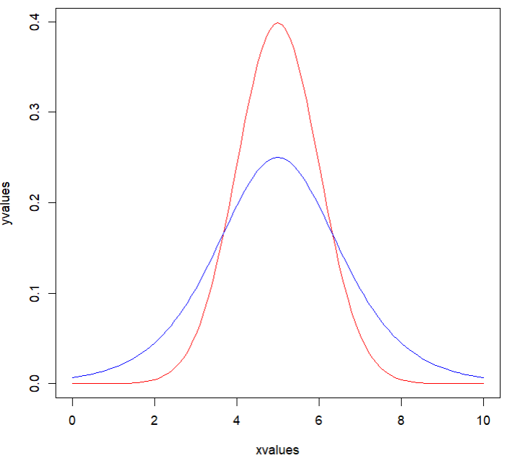
Continuous distributions
Logistic Distribution
Similar to a Normal distribution but with fatter tails (more kurtosis)
Normal distribution
Logistic distribution

Slide 22
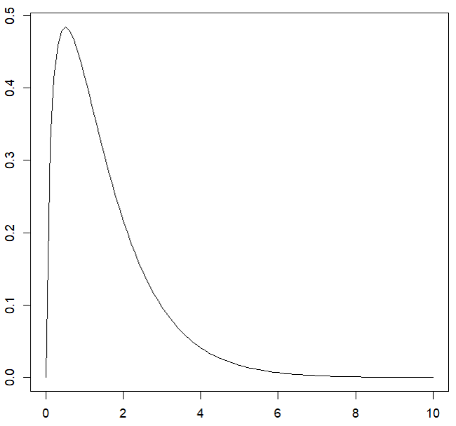
Continuous distributions
Gamma distribution
Model data that is always positive and skewed.
- Continuous counterpart to the negative binomial.
Good to model datasets where variance is much greater than the mean.
E.g. distribution of waiting times until a certain number of events take place.
#Plot a Gamma distribution
xvalues=seq(0,10,length=101)
yvalues=dgamma(xvalues,shape=0.5)
plot(xvalues,yvalues,type="l",main="Gamma Distribution")
#Try changing the shape value to see what happens

Slide 23
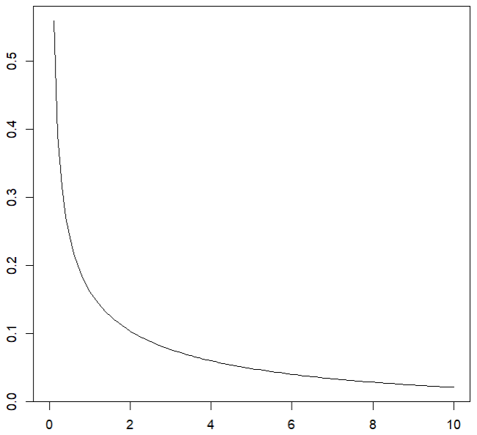
Continuous distributions
Exponential distribution
A special case of the Gamma.
Describes the distribution of waiting times for an event to happen given a constant probability per unit time of happening.
Useful to model inter-event times or lifetimes or to describe a distribution with highest probability close to zero.

Slide 24
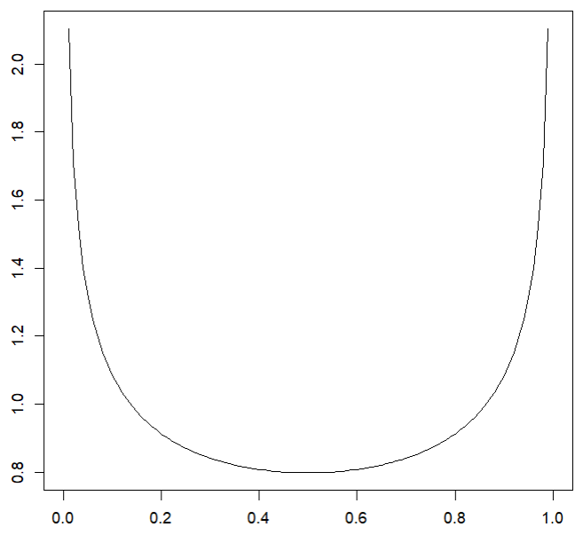
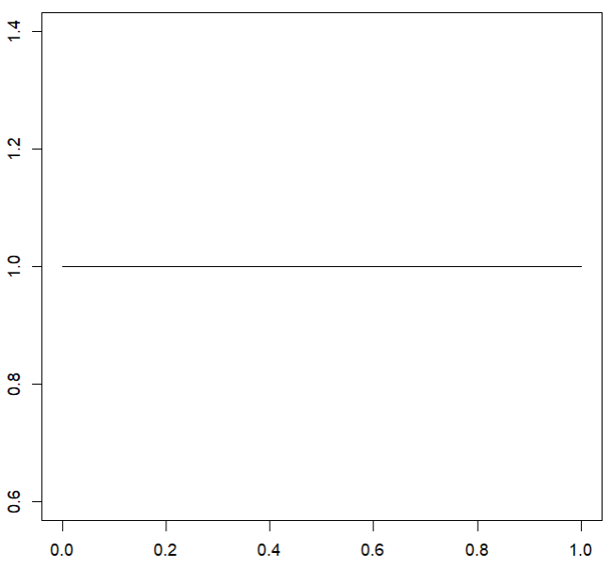
Continuous distributions
Beta distribution
Model data with a limited range (e.g. 0 to 1).
Good to model probabilities or proportions and data with peaks at both ends.
#Plot a Beta distribution
xvalues=seq(0,1,length=101)
yvalues=dbeta(xvalues,0.7,0.7)
plot(xvalues,yvalues,type="l",main="Beta Distribution")
Uniform:
Model data with a limited range (e.g. 0 to 1) where all outcomes are equally probable.
Beta distribution
Uniform distribution

Slide 25
Discrete distributions
Binomial distribution
Counts the number of successes (or failures) in a given number of trials with two possible outcomes, each with a fixed probability
- Useful to model proportions
- Examples: flipping a coin, proportion of infected people in a population, extinction status.
If there is only one trial then it is called a Bernoulli distribution.
Extinct
Extant
5
22

Slide 26
Discrete distributions
Poisson distribution
Distribution of counts (e.g. number of individuals, arrivals, events) where each event is independent of others. It does not have an upper limit (if you expect a ceiling in your counts you would choose the binomial).
The variance is equal to the mean and it only applies to count data.
Negative binomial distribution
Counts the number of failures before a predetermined number of successes takes place. The variance can be greater than the mean (unlike the Poisson) which is good for overdispersed data (more on this later).
Can be used to model birth-death processes.
If we are interested in obtaining one single success, it is called a Geometric distribution.

Slide 27
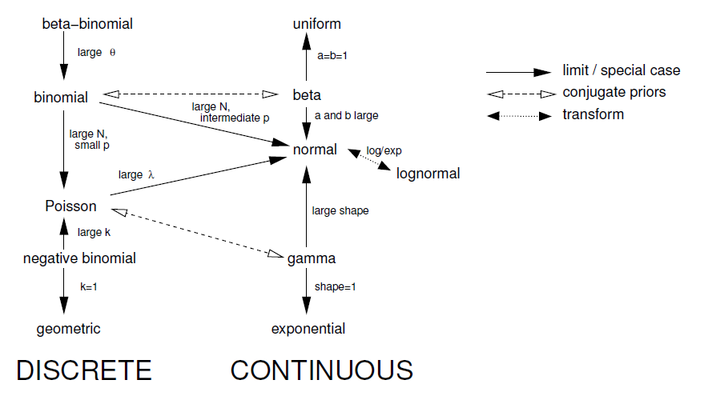
The various distributions are mathematically related
Full list of distributions in R:
https://en.wikibooks.org/wiki/R_Programming/Probability_Distributions
Bolker B. (2007). Ecological Models and Data in R.

Slide 28
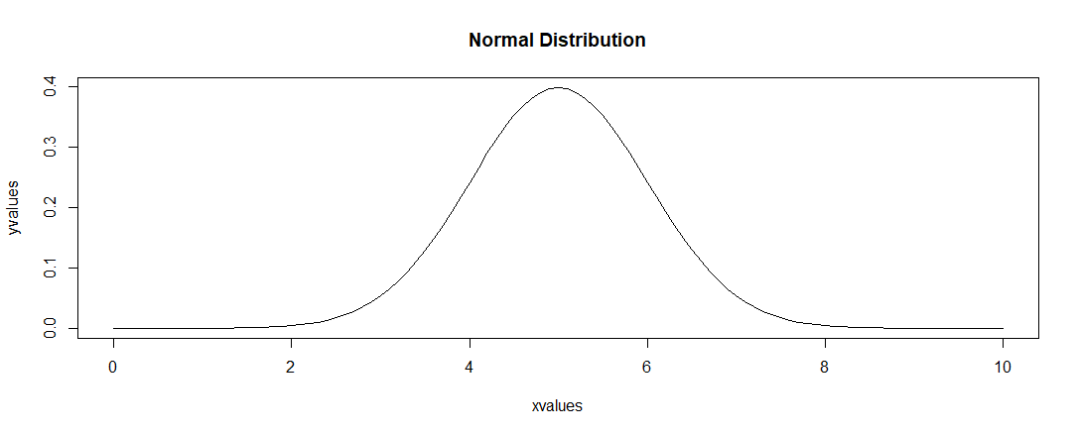
R functions with distributions – example using Normal distribution (dnorm)
Specify a value and get the density of the distribution at that value:
dnorm(x=5,mean=5,sd=1) #0.399: relative likelihood of a value being 5
Specify a value and get the cumulative density below it:
pnorm(q=4.75,mean=5,sd=1) #40% of the sample would be less than 4.75
Specify a cumulative density, get the value (opposite of pnorm):
qnorm(p=0.4,mean=5,sd=1) #4.75 is the value that 40% of observations would be less than
Generate a normally distributed sample with the stated parameters:
rnorm(n=100,mean=5,sd=1) #100 values, mean = 5, sd = 1
Other distributions
Logistic: dlogis
Uniform: dunif
Gamma: dgamma
Exponential: dexp
Beta: dbeta

Slide 29
Part 2: Basic Tests Experimental design

Slide 30
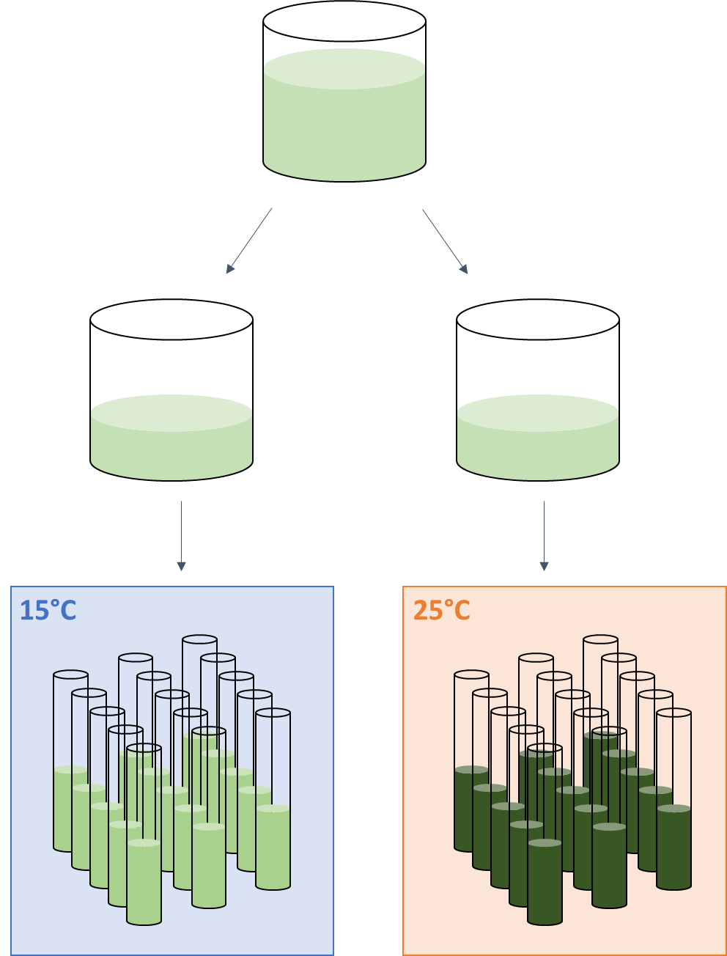
Experimental design: When to use basic tests?
Good for:
- Controlled experiments where you can guarantee that only one explanatory variable is changed
- No need for complicated analyses when a simple test will do!
Example of a controlled study:
I want to know how temperature affects phytoplankton growth.
I split them into two groups of test tubes: (Group A) I grow at 15°C; (Group B) I grow at 25°C. I keep everything else the same (e.g. growth time, culture medium, light level, etc.).
I measure the turbidity (more turbid = more growth) of the cultures in the tubes.
I run a simple test and it tells me that the cultures grown at 25°C are more turbid (more growth).

Slide 31
Experimental design: When NOT to use basic tests?
Not good for:
- Experiments with multiple explanatory variables
- Observational studies where conditions cannot be controlled – many “confounders”!
Example of an observational study:
I measure the abundance of a species in Primary (P) and Secondary forest (S) plots. I want to know if P supports more individuals.
But there’s (i) an altitude gradient which means a temperature gradient; and (ii) a city with a disturbance gradient. These 2 variables may also affect abundance.
I run a test and find that the species is more abundant in S plots.
Is abundance explained by forest type (S vs. P) or the other two gradients or all of them? The simple test cannot account for temperature and disturbance and is therefore not appropriate.
Increasing altitude
P
P
P
P
P
City
Human Disturbance
S
S
S
S
S
S
S

Slide 32
Designing a controlled experiment
1) Create many replicates (to reduce bias) and keep replicates independent
- How many? Do a power analysis (end of this lecture)
2) Between your treatment and your control, change one and only one variable
- What you change is your research question
- If you are interested in 2 variables, then you will need more complicated analyses (future lectures)
3) Keep all other variables constant
- Previous studies/experience will give you information on what is important to control
- If you cannot keep other variables constant, you will need more complicated analyses (future lectures)

Slide 33
Important assumptions about your data!
1) Datapoints are Independent and Identically Distributed
- Independent: individual specimens are not related
Examples of non-independence: same specimen at different times, related specimen
- Identically Distributed: groups to be compared have the same probability distribution and equal variance
2) Distribution of datapoints…
- Follow a normal distribution: use parametric tests
- Is not normally distributed: use non-parametric tests
Main difference: parametric tests use exact values, non-parametric tests use ranks (more robust but less powerful)

Slide 34
Test assumptions

Slide 35
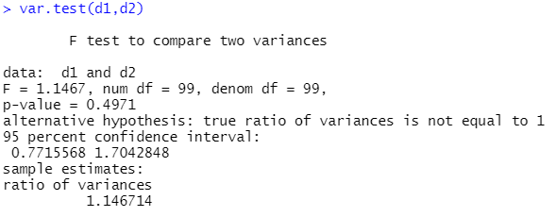
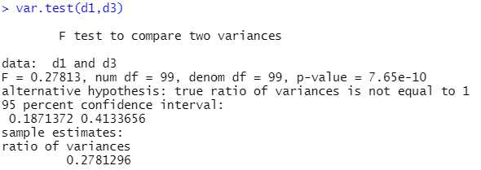
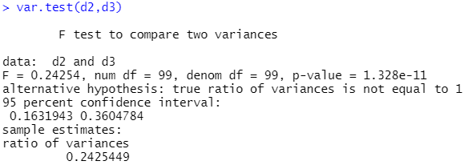
Testing for equal variance
To test whether the variance of two groups of (normally distributed) datapoints are equal.
Fisher’s F test, H₀: variances are equal, H₁: variances are not equal.
#Create 3 datasets
d1=rnorm(100,mean=0,sd=1)
d2=rnorm(100,mean=1,sd=1)
d3=rnorm(100,mean=0,sd=2)
#Test their variances
var.test(d1,d2)
var.test(d1,d3)
var.test(d2,d3)
What does this all mean !??!?!?!??!!?!?

Slide 36
Hypothesis testing using p-values
The tests we run look at your data and tell you the probability that a certain hypothesis (called the “null hypothesis”) is true given your data: the p-value.
H₀: null hypothesis.
- This is your starting “default” assumption
- If your evidence is not strong enough (p-value > 0.05), you cannot reject this belief
- E.g. “The data suggest that there is no significant difference between X and Y.”
H₁: alternative hypothesis.
- This is what you’re trying to see whether your data support
- If your evidence is strong enough (p-value ≤ 0.05), you can claim that this is supported
- E.g. “The data suggest that there is a significant difference between X and Y.”

Slide 37
Hypothesis testing using p-values
Every test has its own null and alternative hypothesis.
Test | Null hypothesis | Alternative hypothesis
Fisher’s F-test | The variances of the two datasets are not different | The variances of the two datasets are different
Shapiro-Wilk test | The data are normally distributed | The data are not normally distributed
One sample t-test | The mean of the data is not different from the specified value | The mean of the data is different from the specified value
Pearson’s chi-squared test | The two categorical variables are independent | The two categorical variables are not independent
Two-proportions test | The two proportions are not different from each other | The two proportions are different from each other
This is our p-value: 0.4971, which means we should ACCEPT our null hypothesis, i.e. the evidence suggests that the variances of d1 and d2 ARE NOT significantly different
The output here very thoughtfully tells you what the alternative hypothesis is (not every test does)
Answer
Answer

Slide 38

But why 0.05?
What does a p-value of 0.05 mean?
If X and Y were the same, there is only a 5% chance of us observing the data that we collected (i.e. a 5% chance that the null hypothesis is true).
Historically decided on by Ronald Fisher (1925).
Fisher, Ronald (1925). Statistical Methods for Research Workers. Edinburgh, Scotland: Oliver & Boyd. ISBN 978-0-05-002170-5.
But it’s not totally arbitrary; there’s a reason based on human intuition…
“Why learn statistics if you can’t use it to win some money?” Chan I.Z.W. (2021)

Slide 39
Testing for equal variance (reprise)
To test whether the variance of two groups of (normally distributed) datapoints are equal.
Fisher’s F test, H₀: variances are equal, H₁: variances are not equal.
#Create 3 datasets
d1=rnorm(100,mean=0,sd=1)
d2=rnorm(100,mean=1,sd=1)
d3=rnorm(100,mean=0,sd=2)
#Test their variances
var.test(d1,d2)
var.test(d1,d3)
var.test(d2,d3)
#Can also test directly from a dataframe
var.test(yvar~xvar,data=dataset)
1
3
2
d1 and d2 are similar
d1 and d3 are different
d2 and d3 are different
Variable to test variance for
Grouping variable

Slide 40
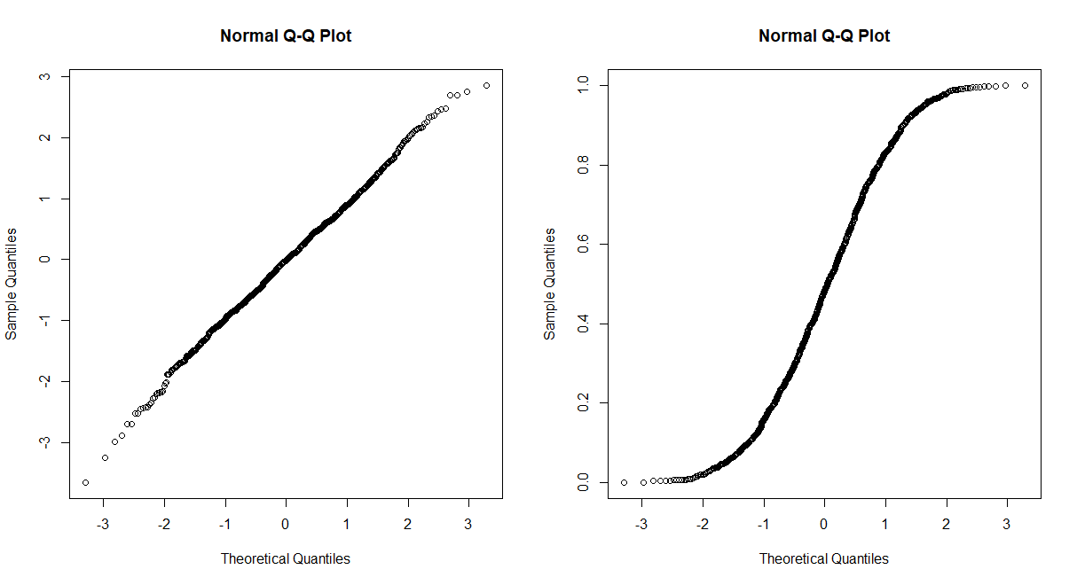
Testing for Normality
To test whether a group of datapoints are normally distributed.
Option 1: Graphical test
Plot a Q-Q plot, i.e. theoretical quantiles from a normal distribution against the actual quantiles in your sample.
#Create a vector of normally distributed data
vecNorm=rnorm(n=1000, mean = 0, sd = 1)
#Create a vector of non-normally distributed data
vecUnif=runif(n=1000, min=0, max=1)
#Basic R code to plot two plots side by side
par(mfrow=c(1,2))
qqnorm(vecNorm)
qqnorm(vecUnif)
Straight suggests normal
S or banana shaped suggests not normal
This function tells R to plot the next 2 plots side by side. Note: you must click the (x) to exit this mode
This function plots a Q-Q plot

Slide 41
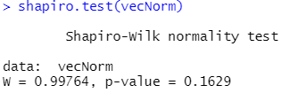
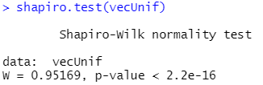
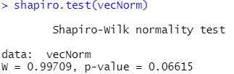
Testing for Normality
There’s also the Kolmogorov-Smirnov test but I prefer Shapiro-Wilk. See: https://stats.stackexchange.com/questions/362/what-is-the-difference-between-the-shapiro-wilk-test-of-normality-and-the-kolmog.
Option 2: Shapiro-Wilk test, H₀: normally distributed, H₁: not normally distributed (P < 0.05).
#Shapiro-Wilk test
shapiro.test(vecNorm) #P = 0.16, cannot reject H₀ (i.e. normal)
shapiro.test(vecUnif) #P < 0.001, confidently reject H₀ (i.e. not normal)
But this test is sometimes over-sensitive:
- Be careful and use both methods

Slide 42
What to do if you have non-normally distributed data?
If you have a dataset that is not normally distributed, you can either:
a) Transform the data (e.g. sqrt, log or take the reciprocal of all the values) and try again (very hit or miss);
#Log transforming a vector
exDat=c(53,46,77,82)
exDat2=log(exDat)
OR
b) Use a non-parametric test (does not assume that the data is normally distributed). We will be using this option by default.
Choosing a transformation
1) Values in your dataset: Sqrt for values ≥ 0. Log and Reciprocal for values > 0.
2) Normalisation “power”, i.e. strength of effect to reduce skew: Sqrt < Log < Reciprocal
3) Sqrt usually works better for count data.
Bottom line: easiest to just try and plot/test.

Slide 43
Basic statistical tests

Slide 44
Basic tests – Analysis decision tree
A
Categorical
Pearson’s Chi-squared test
Start
Explanatory variable type
None
(i.e. comparing data to a predetermined value)
Response variable type
Normally distributed:
One sample t-test
Not normally distributed:
Wilcoxon one sample test
B
Continuous
Categorical
Continuous
C
Categorical
Point Biserial Correlation
Response variable type
Normally distributed:
Pearson correlation
Not normally distributed:
Spearman correlation
D
Continuous
Response variable type
Categorical (contingency table)
E
Continuous
Proportion
Pearson’s Chi-squared test or Fisher’s Exact test
Are specimens paired?
F
Two proportions test
No
G
Normally distributed:
Equal variances: Student’s t-test
Unequal variances: Welch’s t-test
Not normal: Mann-Whitney U test
(aka Wilcoxon rank-sum test)
Yes
H
Normally distributed: Paired t-test
Not normal: Wilcoxon signed-rank test

Slide 45
Chi-squared test on a 1-Way Contingency table
A
To test whether a categorical variable has an effect on the data
H₀: no evidence for an effect, H₁: there is an effect.
Example: after an animal is exposed to a pollutant, its clutch has 31 males and 49 females. You want to test whether this is different from random (i.e. 50% chance of males or females).
#Create the contingency table
count=c(31,49)
#Perform the Chi-squared test
chisq.test(count,p=c(0.5,0.5)) #p=0.044
Note: Can also test for another probability (e.g. 25% chance of Males, 75% of Females) or for three different outcomes (“c(1/3,1/3,1/3)” instead of “c(0.5,0.5)”).
 | Count
Males | 31
Females | 49
This is the null hypothesis you’re testing against: in this case random so 0.5 and 0.5. The values should sum to 1.

Slide 46
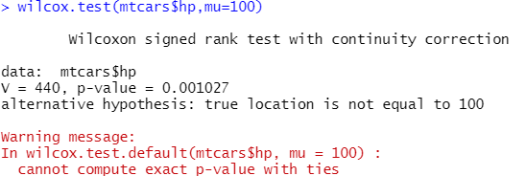
One sample t-test / Wilcoxon one sample test
B
To test if the mean of one group of data is equal to a predetermined value
H₀: mean is not different from the value, H₁: mean is different.
First test whether data are normally distributed:
shapiro.test(mtcars$mpg) #p=0.12
shapiro.test(mtcars$hp) #p=0.049
If normally distributed, use a one sample t-test:
#Test whether the mean is different from 20
t.test(mtcars$mpg,mu=20) #p=0.93
If not normally distributed, use a Wilcoxon one sample test:
#Test whether the mean is different from 100
wilcox.test(mtcars$hp,mu=100) #p=0.001
wilcox.test(mtcars$hp,mu=100,exact=F) #p=0.001
Warning message. How to solve? Try Googling…
Answer

Slide 47
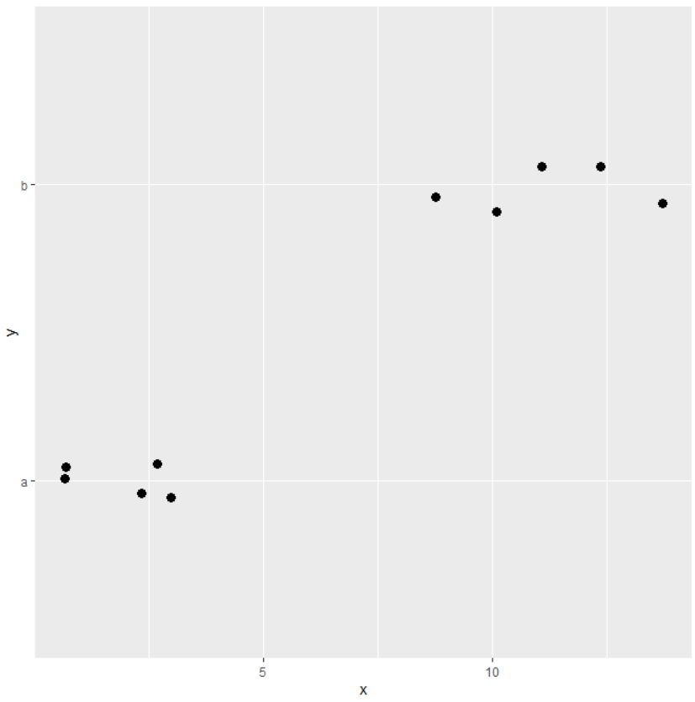
Point Biserial Correlation
C
To test whether an explanatory continuous variable and a categorical response variable are independent (no effect on each other) or correlated (vary together)
H₀: independent, H₁: correlated.
#Create the continuous x and categorical y variables
x=c(1,11,2,14,3,9,1,12,3,10)
y=c("a","b","a","b","a","b","a","b","a","b")
#Testing Assumption 1
shapiro.test(x) #p=0.084
boxplot(x) #look for outliers: none
#Testing Assumption 3
#Splitting “a” and “b” into 2 vectors
xA=x[which(y=="a")]
xB=x[which(y=="b")]
var.test(xA,xB) #p=0.23
Species hunted
Point Biserial Test assumptions:
1) Continuous variable is normally distributed and has no outliers
2) Categorical variable only has 2 levels
3) Equal variance in the two groups of the categorical variable
4) The relationship is linear
Jaw size of individual

Slide 48
Point Biserial Correlation
C
The result makes sense, it looks like individuals with larger jaw size (x-axis) tend to prefer preying on species b (upper value on y-axis)?
#Performing Point Biserial Correlation
cor.test(x,y) #Error: y must be numeric
#Convert y to numeric with 2 values first
yNum=y
yNum[which(yNum=="a")]=1
yNum[which(yNum=="b")]=2
yNum=as.numeric(yNum)
#Calculating Point Biserial Correlation with new yNum
cor.test(x,yNum) #p<0.001
Species hunted
Jaw size of individual

Slide 49
Pearson and Spearman Correlation
D
To test whether two continuous variables are independent or correlated.
H₀: Independent, H₁: correlated.
If both normally distributed, use Pearson Correlation:
shapiro.test(mtcars$mpg) #p=0.1229
shapiro.test(mtcars$drat) #p=0.1101
cor.test(mtcars$drat,mtcars$mpg) #p<0.001
If at least one non-normal, use Spearman Correlation:
shapiro.test(mtcars$hp) #p=0.049
cor.test(mtcars$drat,mtcars$hp,method="spearman") #p=0.002

Slide 50
Chi-squared test or Fisher’s Exact test on a 2-way Contingency table
E
To test whether two categorical variables are independent (do not affect each other) or associated (affect each other)
H₀: independent, H₁: associated.
Example: in this contingency table we have counts of all the times that a combination of two categorical variables happened, i.e. (i) Colour A or B in crabs and (ii) whether a Fight occurred. Question: Are Colour and Fight associated? We use a Chi-squared test to compare the Observed counts to the Expected counts if the variables were independent (i.e. equal proportions of Fight/No fight in Colour A and B).
From a contingency table of counts
count=matrix(c(53,231,426,298),nrow=2)
#Perform the Chi-squared test
chisq.test(count) #p<0.001
#If any of the Expected values are < 5, perform Fisher's Exact test instead
fisher.test(count) #p<0.001
 | Fight | No fight
Colour A | 53 | 426
Colour B | 231 | 298
The values in our data are the Observed values. In most cases, Expected values are the values if all categories had an equal number.
Using our example, the expected value for each category would be: (53+231+426+298)/4 = 252 (this is > 5)

Slide 51
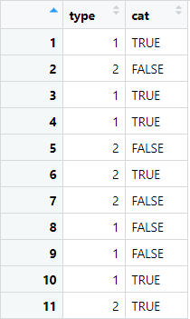
Chi-squared test or Fisher’s Exact test on a 2-way Contingency table
E
Directly from a dataframe
You can also run the test directly from categorical variables within a dataframe (i.e. no need to create a matrix), the chisq.test() command is smart enough to recognise what you’re keying in
#Create a dataframe with two categorical variables
cDat=data.frame(
type=c(1,2,1,1,2,2,2,1,1,1,2),
cat=c(T,F,T,T,F,T,F,F,F,T,T)
)
#Perform the Chi-squared test
chisq.test(x=cDat$type,y=cDat$cat) #p=0.78

Slide 52
Two proportions test
F
To test whether two proportions are significantly different from each other
H₀: no evidence of a difference, H₁: evidence for a significant difference
Example: in a herbicide experiment…
- Control plot (without herbicide): 10 out of 876 seedlings die; - Herbicide-treated plot: 7 seedlings out of 233 die.
Is this by chance alone? Is there any evidence the herbicide was effective?
#Run the two proportions test
prop.test(c(10,7),c(876,233)) #p=0.079
#Note: the command takes 2 vectors, the first containing number of “successes”, the second taking the total number of trials; in order.

Slide 53

Student’s t-test / Welch’s t-test
G
To test whether the means of two groups with normally distributed data are significantly different, H₀: no evidence for a difference, H₁: the means are significantly different.
Example: dataset on <age> and pollutant <levels> (response variable) in two <group>s of animals (explanatory variable)
Test whether the response variable is normally distributed:
d1=read.csv("ageData.csv")
shapiro.test(d1$age) #p=0.1229: normal
shapiro.test(d1$levels) #p=0.049: non-normal(?)
If normally distributed, test for equal variances:
var.test(age~group,data=d1) #p=0.1997

Slide 54
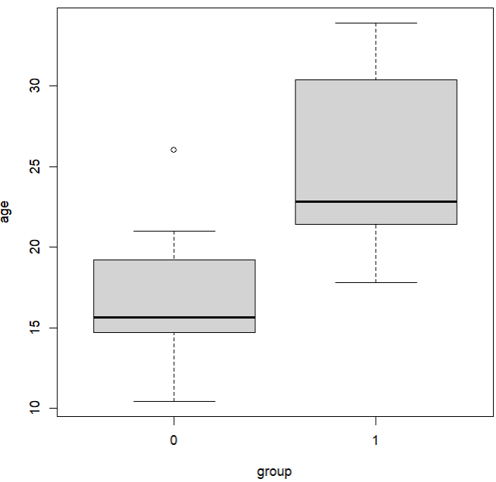
Student’s t-test / Welch’s t-test
G
If variances are equal, do Student's t-test:
t.test(age~group,data=d1) #two-tailed: are the means different?; p<0.001
t.test(age~group,data=d1,alternative="less") #one-tailed, is "0" < "1"? (alphabetical); p<0.001
t.test(age~group,data=d1,alternative="greater") #one-tailed, is "0" > "1"?; p=1
boxplot(age~group,data=d1) #see if the results make sense
If variances are NOT equal, do Welch's t-test:
t.test(age~group,data=d1,var.equal=F) #p<0.001 (can also run other alternative hypotheses)

Slide 55
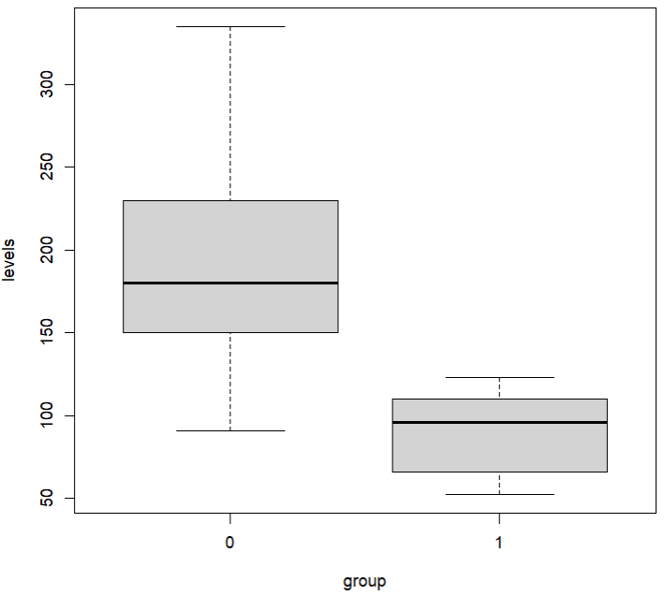
Mann-Whitney U test
G
If the response data is non-normally distributed:
shapiro.test(d1$levels) #p=0.049
Use the Mann-Whitney U test:
(same as before, H₀: no evidence for a difference, H₁: means are significantly different)
wilcox.test(levels~group,data=d1) #p<0.001
wilcox.test(levels~group,data=d1,alternative="less") #p=1
wilcox.test(levels~group,data=d1,alternative="greater") #p<0.001
boxplot(levels~group,data=d1) #see if the results make sense

Slide 56
Student’s t-test / Welch’s t-test / Mann-Whitney U test with separate vectors
G
In the previous slides, we used a grouping variable in a dataframe <d1$group> to tell R what our 2 groups are. If your data are in 2 separate vectors (one vector for each group), we can also compare them directly.
Subset the <level> variable into 2 vectors based on <group>:
levels0=d1$levels[d1$group==0]
levels1=d1$levels[d1$group==1]
Run a Mann-Whitney U test:
wilcox.test(levels0,levels1)
Subset the <age> variable into 2 vectors based on <group>:
age0=d1$age[d1$group==0]
age1=d1$age[d1$group==1]
Run a t-test
t.test(age0,age1,var.equal=F) #two-tailed; can also run both one-tailed tests

Slide 57
Paired t-test / Wilcoxon signed-rank test
H
To test whether the means of two groups of related samples are different
H₀: no evidence of a difference, H₁: the means are different.
Examples:
- Paired over time: comparing biodiversity in 10 sites at T=1 vs. T=2
- Paired by relationship: comparing weight of male vs. female offspring from 10 pairs of parents
Assuming that our previous data was actually paired…
If normally distributed, use a Paired t-test:
t.test(age0,age1,paired=TRUE) #Can also add "var.equal=F" if needed
If not normally distributed, use a Wilcoxon signed-rank test:
wilcox.test(levels0,levels1,paired=TRUE)
Before data
After data
Paired
Must be in the same order

Slide 58
Other considerations

Slide 59
Correcting for multiple comparisons
Be very careful if you perform multiple tests in your study!
Example:
- If you have 3 groups (A, B and C) and you want to compare them all, you may decide to perform 3 tests: A vs. B; A vs. C; and B vs. C.
- This increases the chance of getting a significant result due to random chance, especially if you make 10s or 100s of comparisons! (recall that p=0.05 is a 1 in 20 chance)
There are a multiple ways to correct for this, I introduce 2…
1) Bonferroni correction: multiply your p-values (or divide your cut-off value, usually 0.05) by the number of comparisons conducted. The most strict but least powerful (i.e. most likely to incorrectly reject a significant result).
2) Benjamini & Hochberg (BH) correction (aka False Discovery Rate, FDR): calculates a critical value using the ranks of your p-values and rejects results based on that. A good balance between strictness and power.

Slide 60
Correcting for multiple comparisons
Example: You did 20 comparisons and got these p-values
pVals=c(0.56,0.0001,0.032,0.045,0.12,0.44,0.22,0.013,0.54,0.72,0.11,0.35,0.003, 0.53,0.17,0.05,0.051,0.23,0.59,0.67)
Apply your chosen correction to the p-values:
#Correct using Bonferroni
pBf=p.adjust(p=pVals,method="bonferroni")
which(pBf<0.05) #2 only (more stringent)
#Correct using BH
pBH=p.adjust(p=pVals,method="BH")
which(pBH<0.05) #2 and 13 (less strict)

Slide 61
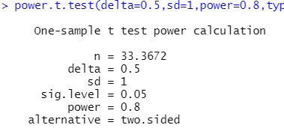
Power analysis
Imagine you spend months doing an experiment and end up having no significant result. Is it because there is really no effect or your sample size was too small?
- You can’t tell! Unless…
Power analysis is good to do before an experiment to estimate how big your sample size needs to be in order to detect that something has an effect and get a significant result.
For t-test: to detect an effect of 0.5 in data with SD=1 (power is usually set at 0.8 by default):
power.t.test(delta=0.5,sd=1,power=0.8,type="one.sample")
power.t.test(delta=0.5,sd=1,power=0.8,type="two.sample")
power.t.test(delta=0.5,sd=1,power=0.8,type="paired")
You need at least n=34

Slide 62
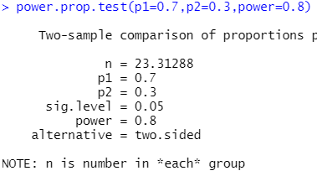
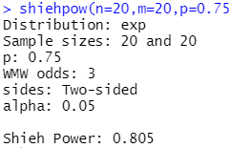
Power analysis
For Two proportions test: to detect a difference between 2 groups with actual success rates of 0.7 and 0.3 (power also 0.8 by default):
power.prop.test(p1=0.7,p2=0.3,power=0.8)
For Mann-Whitney U test: to detect a difference between 2 time-till-event datasets (exponential distribution):
install.packages("wmwpow")
library(wmwpow)
shiehpow(n=20,m=20,p=0.75,dist="exp")
#p is the effect size, proportion of the time that you would expect a random value from n to be smaller than a random value from m
#Manually change n and m to try to get Shieh Power > 0.8

Slide 63
Summary (Learning Objectives)
Basic statistical concepts
- Variable types:
Properties: Continuous vs. Categorical vs. Discrete
Function: Explanatory vs. Response
- Describing data: Mean, Variance, df, SD, SE, Confidence Intervals
- Modelling data with Distributions: continuous and discrete
Basic statistical tests
- Experimental design
- Test assumptions: Independent and Identically Distributed, normality, equal variances; testing for normality and equal variances
- Tests: based on number and type of explanatory and response variables
- Other considerations: Corrections for multiple comparisons, Power analysis
Notes:
Pearson’s Chi-squared test, one-sample t-test, Wilcoxon one-sample test, point biserial correlation, Pearson/Spearman correlation, Pearson’s Chi-squared/Fisher’s Exact test, Two proportions test, t-test, Welch’s t-test, Mann Whitney U test, Paired t-test, Paired Wilcoxon signed rank test

